Slide 1
Mixed Ratio Problems
EQ: Where could I use this in a real world situation?

Slide 2
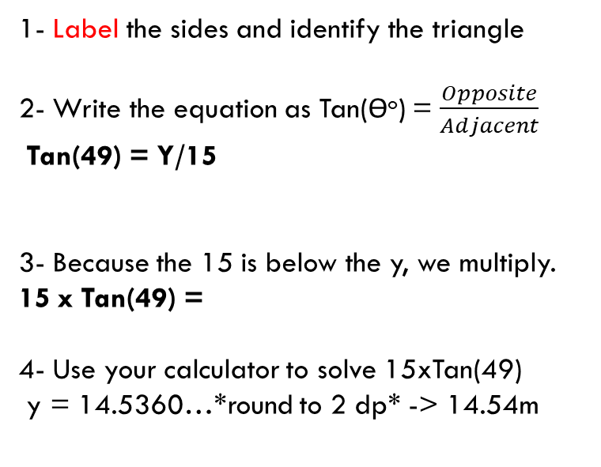
Mixed Ratio Problems
EQ: Where could I use this in a real world situation?
1- Label the sides and identify the triangle
2- Write the equation as Tan(ϴº) = $\frac{Opposite}{Adjacent}$
Tan(49) = Y/15
3- Because the 15 is below the y, we multiply.
15 x Tan(49) =
4- Use your calculator to solve 15xTan(49)
y = 14.5360…*round to 2 dp* -> 14.54m
Opposite
Y
49º
15 m
Adjacent

Slide 3

Mixed Ratio Problems
EQ: Where could I use this in a real world situation?
1- Label the sides
2- (ϴº) = $\frac{Opposite}{Adjacent}$
15 m
Y
29º
Practise Question

Slide 4
Mixed Ratio Problems
EQ: Where could I use this in a real world situation?
32º
Y
8 m
Practise Question

Slide 5
Mixed Ratio Problems
EQ: Where could I use this in a real world situation?
13 m
29º
Practise Question
Y

Slide 6
Mixed Ratio Problems
EQ: Where could I use this in a real world situation??
10 m
Y
59º
Practise Question

Slide 7
Mixed Ratio Problems
EQ: Where could I use this in a real world situation?
Y
39º
Practise Question
13 m

Slide 8
Mixed Ratio Problems
EQ: Where could I use this in a real world situation?
Y
29º
Practise Question
9 m

Slide 9
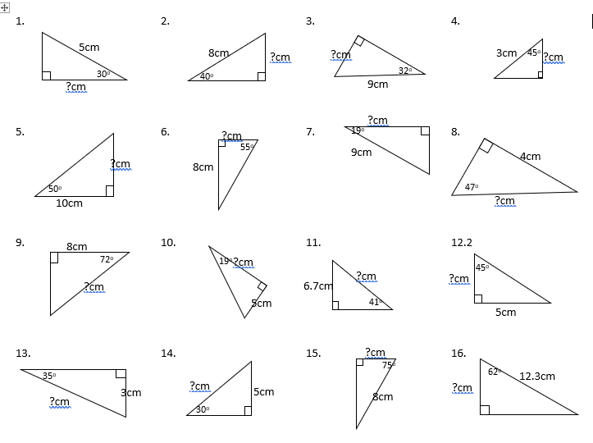
Complete the mixed question worksheet

